Slide 1

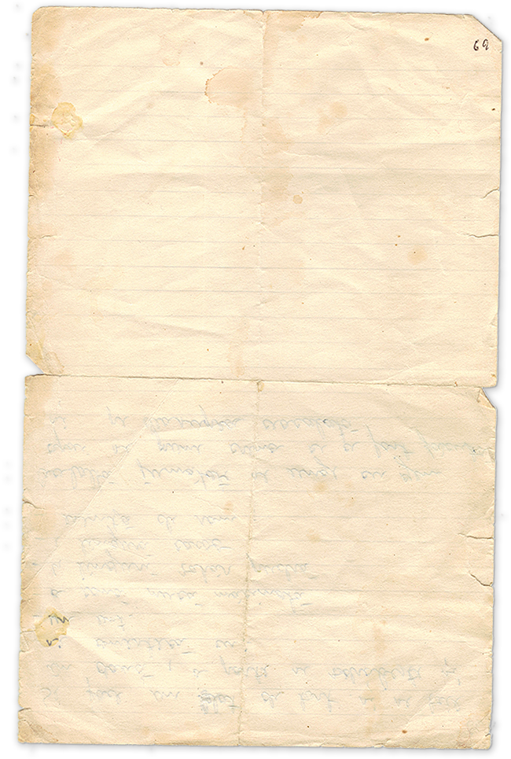
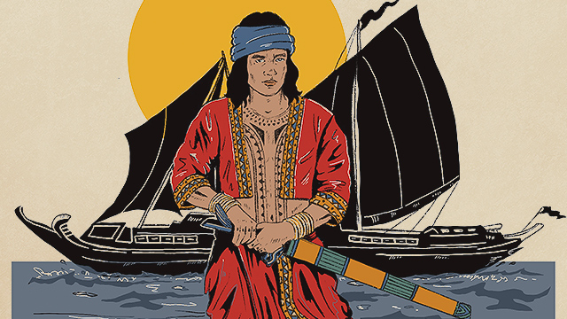

BANTUGAN

Slide 2

Members
Aira Verola
Victor Concillo
Josh Pecayo
Sanny Boy Samsodin
Mansor Malik
Cris Parcon
Bea Colita
Christian Dañoso

Slide 3
What is Epic?
A long narrative poem written in elevated style, in which heroes of great historical or legendary importance perform valorous deeds.

Slide 4
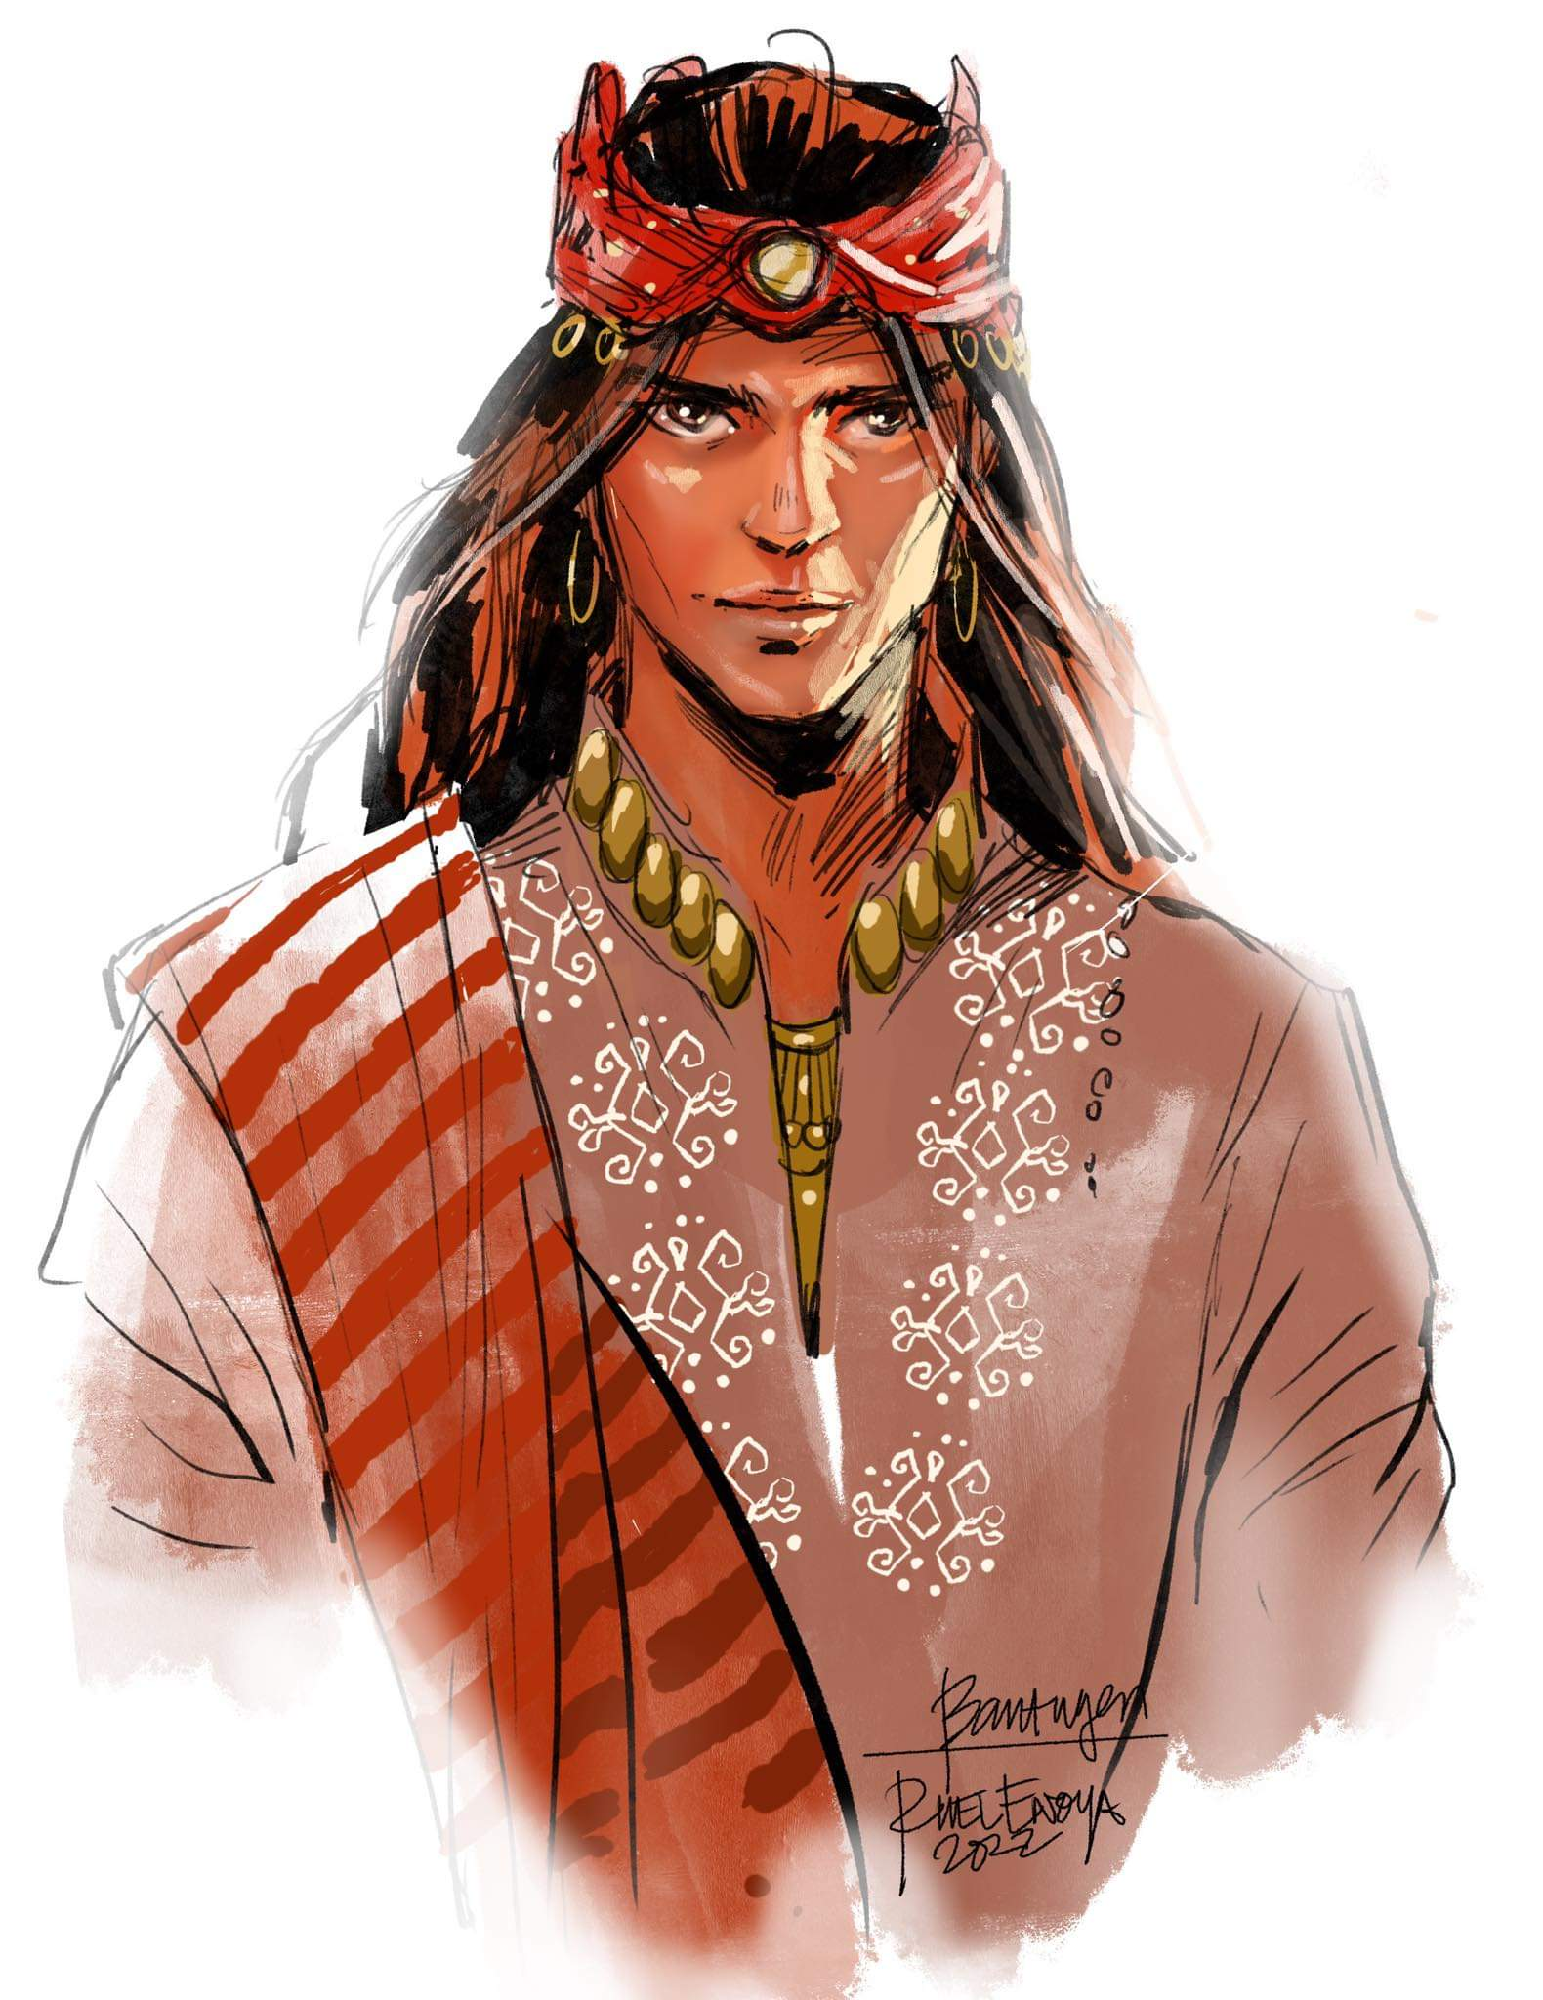
Introduction
Bantugan is a legendary Maranao epic about a mighty warrior prince of Bumbaran. Banished by his jealous brother, King Madali, Bantugan embarks on heroic adventures but falls gravely ill. His soul is taken to the land of the dead, but through his brother’s redemption, he is revived, proving his destiny as a true hero.

Slide 5

Major Characters
Prince Bantugan: The protagonist, a brave and virtuous prince who is loved by his people. He is known for his bravery and is often depicted as a hero.

Slide 6
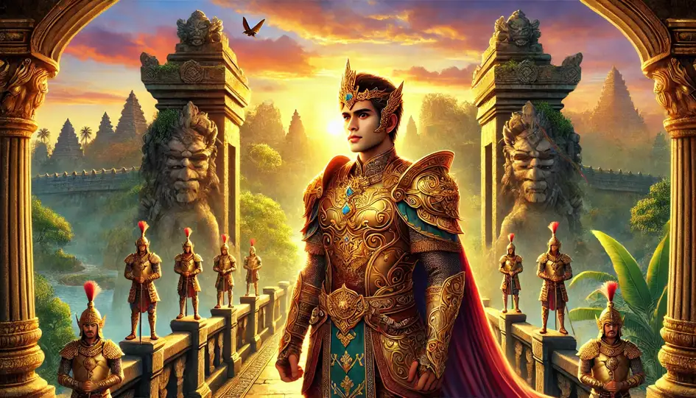
Major Characters
King Madali: Bantugan's father, ruling the kingdom with wisdom. Princess Datimbang: Bantugan's sister, portraying resilience and intelligence.

Slide 7
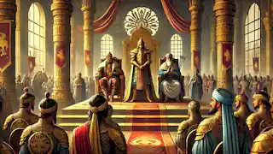
Major Characters
Bantugan's loyal companions: Supporting characters who aid Bantugan in his journey. King of Bumbaran: Bantugan's brother, who envies him.

Slide 8
Major Characters
King Miskoyaw: The ruler of Panggadusan who captures Prince Bantugan's soul in the Maranao epic "Darangen."

Slide 9
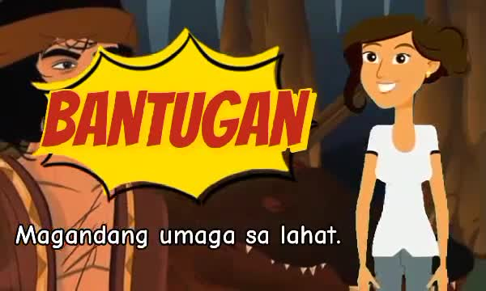
Video

Slide 10
Summary
Bantugan was a brave warrior from the Maranao epic Darangan, known for his victories in battle and admired in the kingdom of Bumbaran, especially by many princesses. His older brother, King Madali, grew jealous and forbade anyone from speaking to Bantugan. Saddened, Bantugan left the kingdom, fell ill, and died near the Land Between Two Seas. King Madali, regretting his actions, reclaimed Bantugan’s soul from heaven, bringing him back to life. When a neighboring king, Miskoyaw, attacked Bumbaran and captured Bantugan, he regained his strength, defeated the enemy, and saved the kingdom. King Madali’s jealousy faded, and Bantugan lived happily with the princesses he married.

Slide 11
Belief
The Epic of Bantugan is that jealousy and pride can lead to regret, but love and courage can bring redemption. King Madali’s envy drove Bantugan away, but in the end, he realized his mistake and worked to bring his brother back. Despite the hardships Bantugan faced, his bravery and kindness never wavered. He not only saved himself but also protected his kingdom when it needed him the most. This story teaches us that true strength is not just about winning battles it’s about forgiveness, resilience, and staying true to who you are.

Slide 12
Importance
Major Challenges
Bantugan's struggles show that everyone faces adversity, regardless of strength or status. This reminds us that resilience and kindness are essential qualities.
Effects of Pride and Jealousy
The epic highlights how negative emotions like pride and jealousy can lead to mistakes, encouraging self-reflection on our own behaviors.

Slide 13
Importance
Redemption
King Madali's redemption provides hope and shows that even after making mistakes, there's always a chance for forgiveness and reconciliation. This offers inspiration for personal growth.
Family and Forgiveness
The story emphasizes strong family bonds and the transformative power of forgiveness, highlighting their importance in our own relationships.

Slide 14
Importance
Honored Strengthen
Bantugan's actions demonstrate that true strength comes from honor, integrity, and selfless acts of bravery, inspiring us to strive for these qualities.

Slide 15
Conclusion
The Epic of Prince Bantugan is not just a historical tale; it’s a timeless story that continues to resonate with people today, just like maranaoan people, offering valuable life lessons applicable to old times and until modern life.

Slide 16
Perspective
1. Cultural Perspective
- The epic provides insights into the Maranao culture, particularly their concepts of bravery, honor, family loyalty, and the consequences of envy.
- It highlights the hierarchical and feudal nature of their society, where kings and princes are central figures, and loyalty to a leader is highly valued.
- The intervention of the gods reflects the Maranao belief in the supernatural realm and its role in human affairs.

Slide 17
Perspective
2. Moral and Ethical Perspective
- The story emphasizes the virtues of courage, loyalty, and forgiveness while cautioning against the dangers of jealousy and pride.
- Bantugan's eventual resurrection could symbolize redemption and the triumph of good over personal flaws or societal challenges.

Slide 18
Perspective
3. Heroic Perspective
- The narrative places Bantugan in the archetype of the hero’s journey, common in epics worldwide. He faces challenges, experiences a downfall (his death), and eventually rises again, demonstrating the enduring nature of heroism.
- His adventures also symbolize the universal human quest for identity, honor, and purpose.

Slide 19
Perspective
4. Community Perspective
- The epic shows the importance of kinship and community in the Maranao society. The reactions of the characters, from Bantugan’s brother to the gods, illustrate how individual actions can affect the entire kingdom.
- It stresses the idea that the welfare of the community often depends on the actions and character of its leaders.

Slide 20
Perspective
5. Gender Perspective
- Bantugan’s heroic qualities, such as strength and charisma, reflect traditional ideas of masculinity in the Maranao context.
- The role of women, such as the goddesses and caretakers in the story, can also be explored to understand their place in the narrative and society.

Slide 21
ARIGATHANKS!

